Slide 1
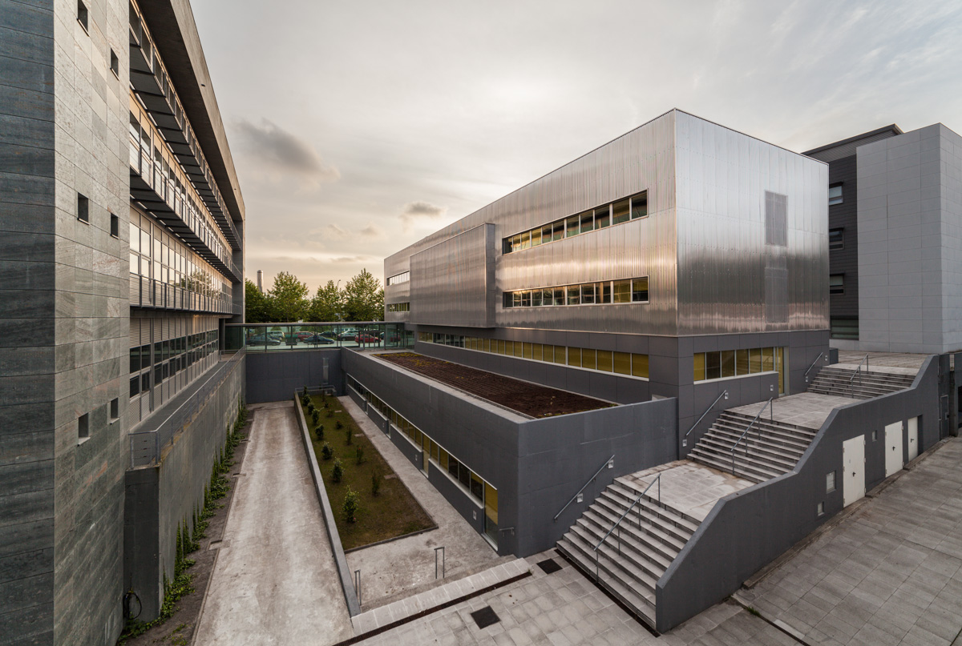
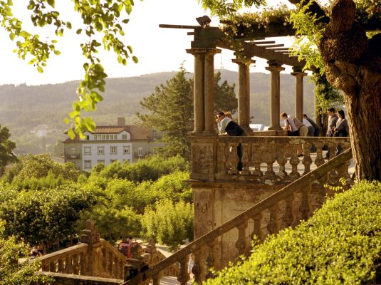
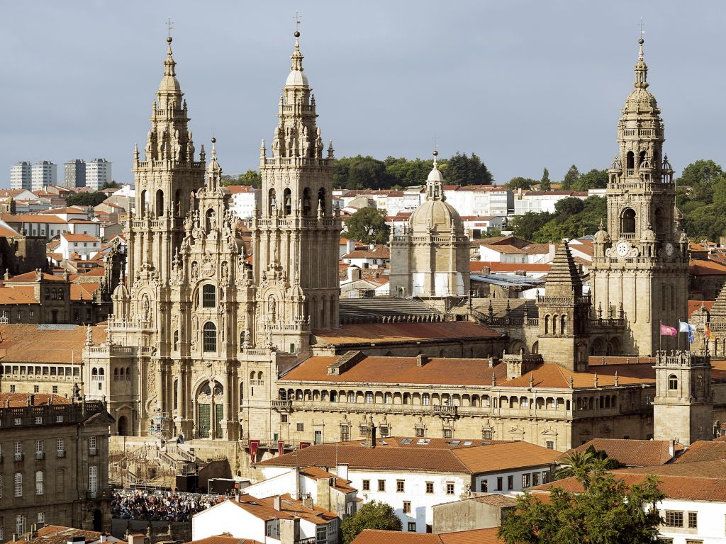
TEAM
+150 PEOPLE
31 SENIOR RESEARCHERS
citius.gal
COORDINATED EUROPEAN PROJECTS
R&D RESULTS 2021-23
NANOVR
ERC Consolidator Grant
Nanoscale Design using Virtual Reality
ARTICLES
75% in Q1
44% in D1
10M
€
21% income from
european projects
27% in top 10% most cited
OPPORTUNITIES FOR POSTDOCS
Juan de la Cierva contracts
Ramón y Cajal contracts
Marie Sklodowska-Curie Postdoctoral Fellowships (MSCA-PF)
ERC-Starting Grant
Postdoc CiTIUS
Welcome package with special benefits for each call. Contact us!
Interactive Natural Language for Explainable AI (Coordinator)
Multimodal Fusion of Sensor Information
Based in Santiago de Compostela, UNESCO World Heritage City. One of the 100 best places in the world by TIME Magazine 2021.
Hybrid intelligence to monitor, promote and analyse transformations in good democracy practices
SPIN-OFFS
citiususc
citius.kmt@usc.es

